Slide 1

Credit Cards Default Payments
Gabriel Reynoso
Luis Delfín
Juan Pablo Harfush

Slide 2

Introduction
During 2013…
Americans charged more than 2 trillion dollars into their credit cards.
In debts, they accumulated more than 850 billion dollars from which only about 100 billions where payed.
Our Goal…
Our main objective is to classify credit card users based on their personal characteristics and their credit card records.
The purpose of our binary classification is to be able to determine whether a client is likely to pay its credit card or not.

Slide 3
Dataset
University of California, Irvine
One dataset of 24 columns x 30,000 rows
Donated in 2016, contains data from 2005

Slide 4
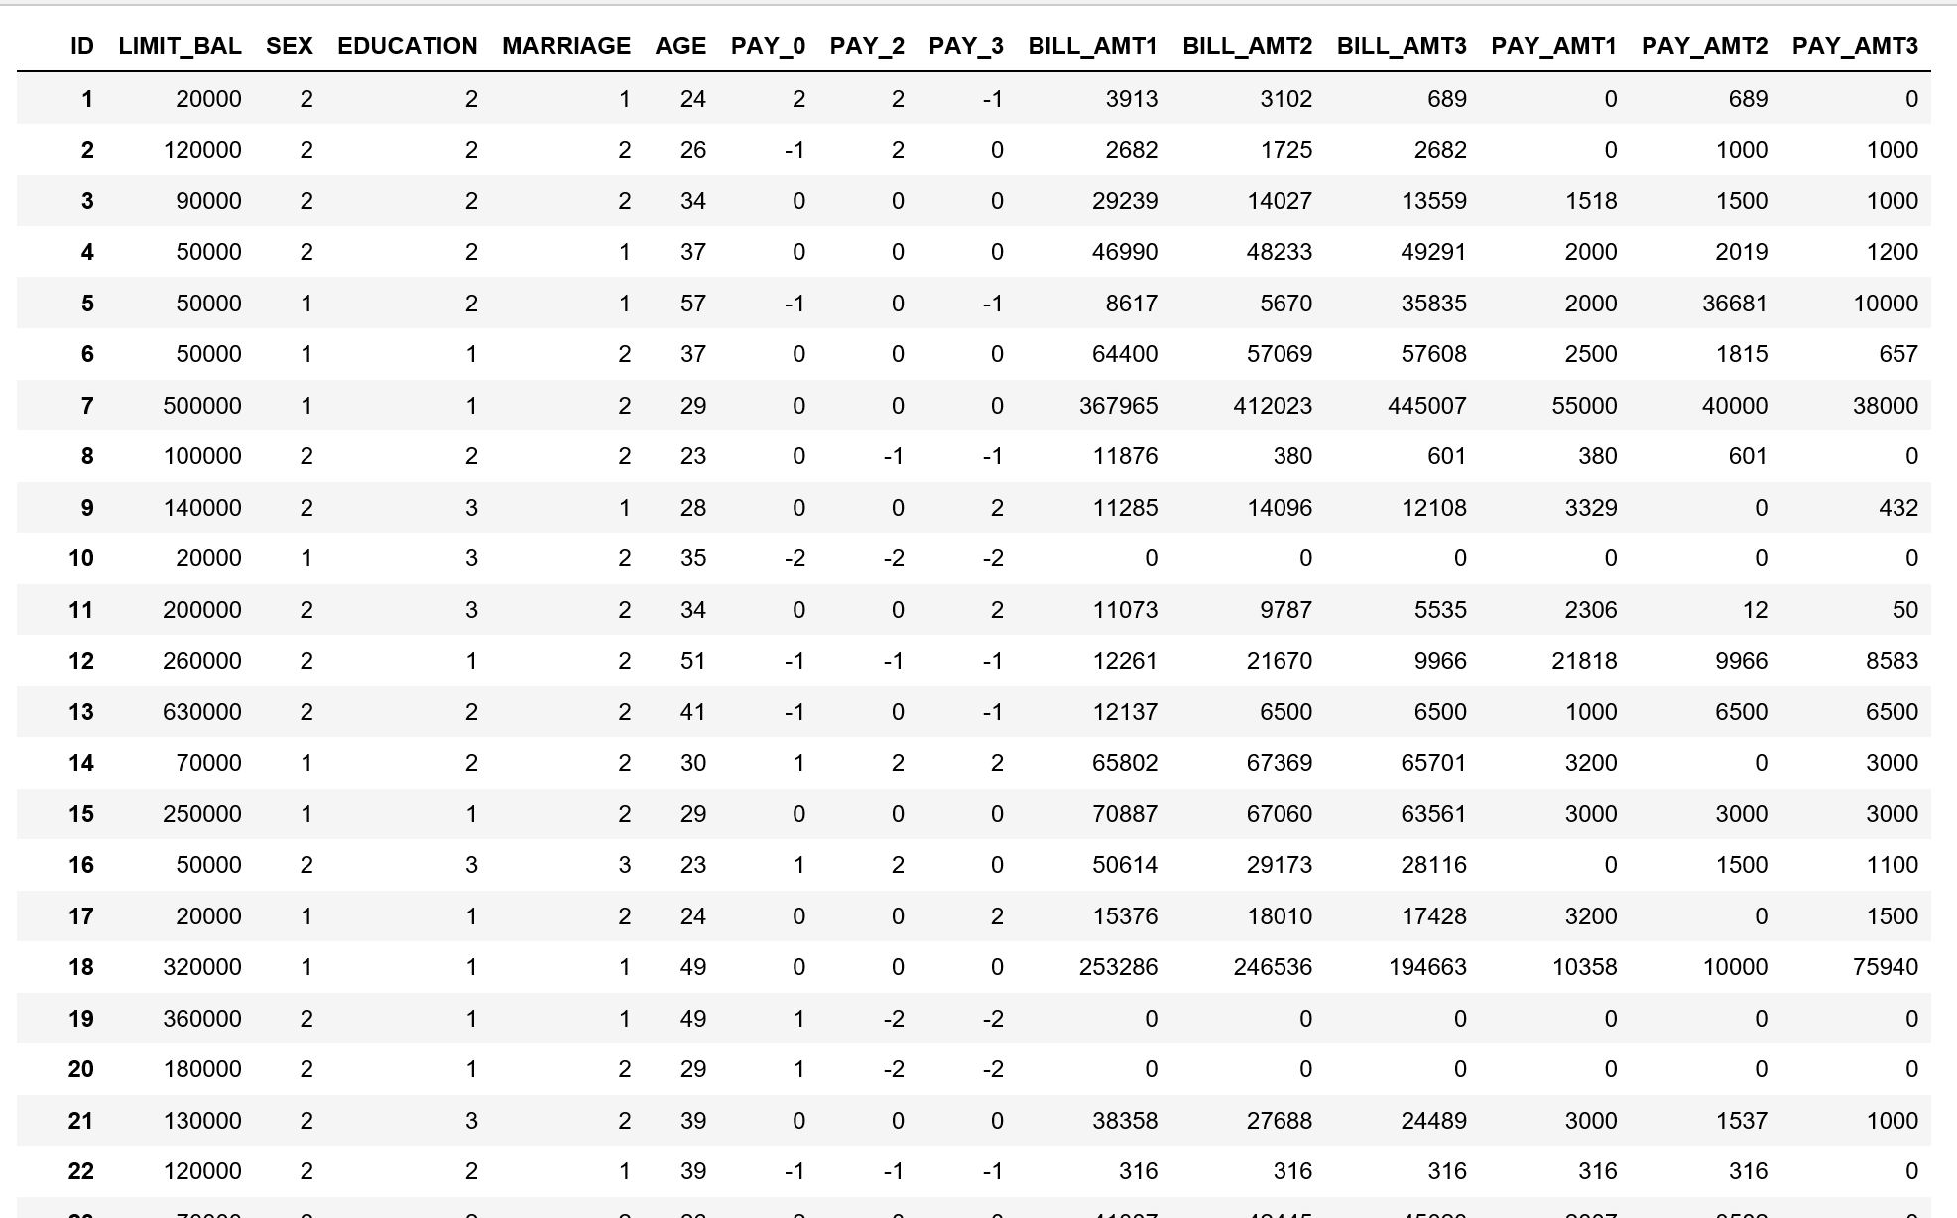

Slide 5

Exploratory Data Analysis

Slide 6
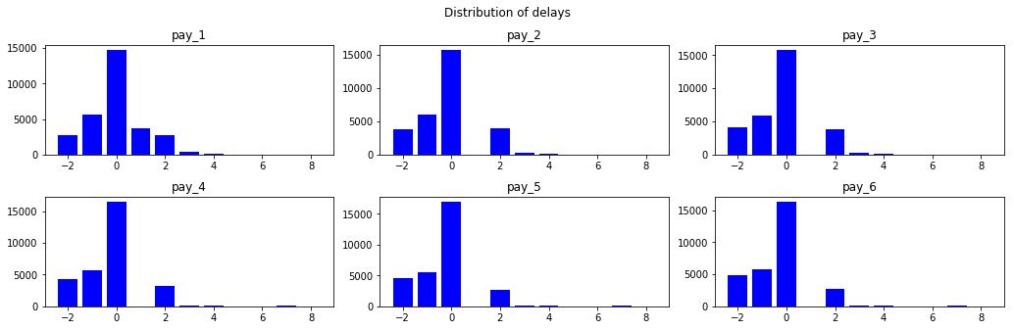
Distribution of delays

Slide 7
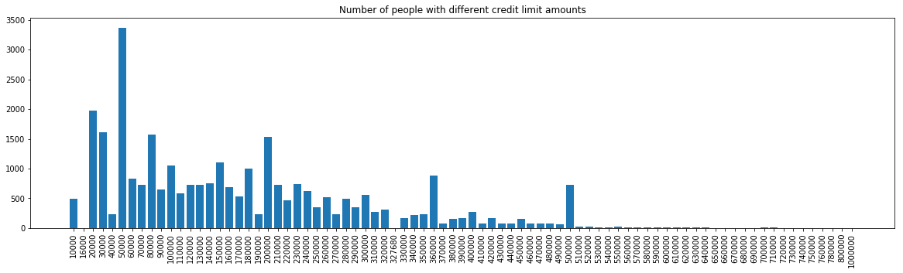
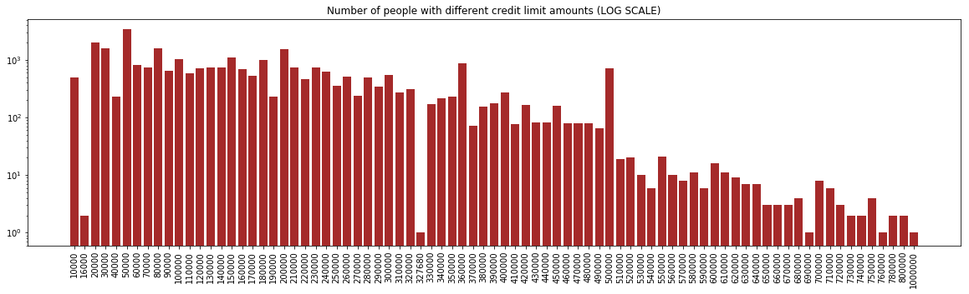
Credit Limit Amounts

Slide 8
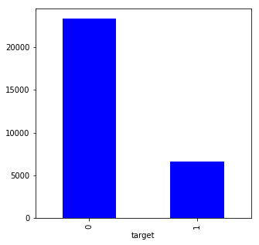
How many have defaulted to pay?
22.12%

Slide 9
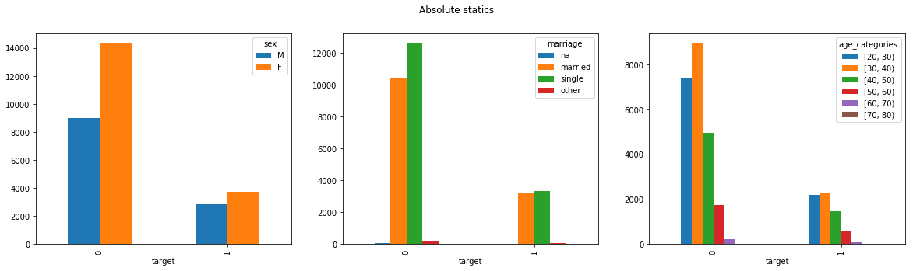
Is it related to gender, age or marital status?

Slide 10

Feature Engineering
Categorical attributes: marital status, sex, level of education and pay delays records.
Range category attributes: age and credit limit.
Average payment per month.
Logarithm of pay amount per month.
Logarithm of bill balance per month.
Bill balance relative to the credit limit per month.

Slide 11
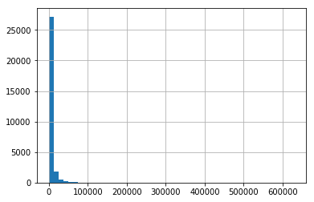
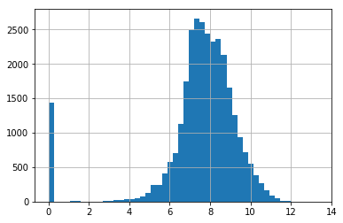
Average Payment
Average Pay Amount
Log (average pay amount)

Slide 12
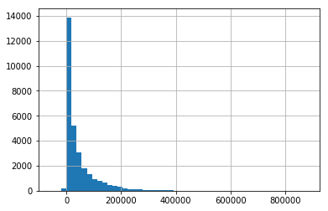
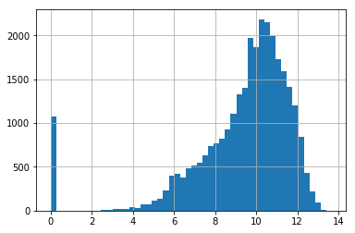
Average Bill
Number of people
Average Bill Amount
Number of people
Log (average bill amount)

Slide 13
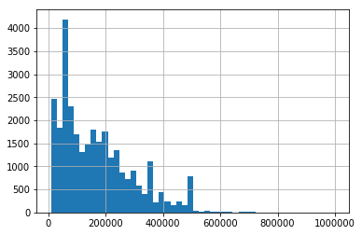
Credit Limit
Number of people
Credit limit

Slide 14
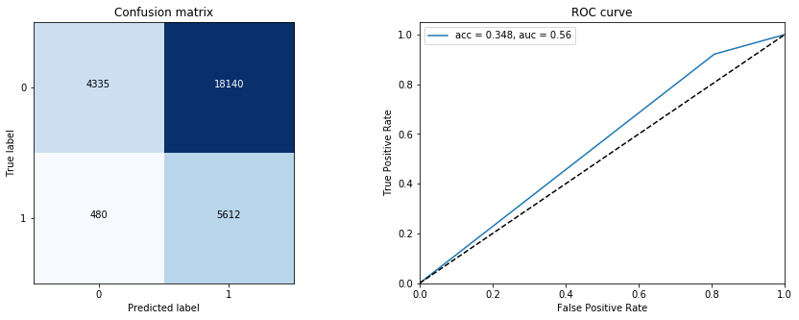
First Modeling Approach – Naïve Bayes Model

Slide 15
Pre-Processing
After one-hot encoding: 221 features
Min-Max Scaler applied to all features
We selected the 30 most important features (SelectKBest, f_classif)
Some of them:
Mean pay delay
Pay delays (1-6) [C]
Average payment log
Limit balance log
Relative bill amount

Slide 16

Data Modelling

Slide 17
Models Accuracy and AUC
Model | Accuracy | AUC
Naive Bayes | 79.85% | 0.71
Random Forest Classifier | 81.16% | 0.64
Gradiant Boosting Classifier | 82.64% | 0.66
Ada Boost Classifier | 82.46% | 0.66
Bagging Classifier | 80.98% | 0.63
KNeighbors Classifier | 80.64% | 0.65

Slide 18
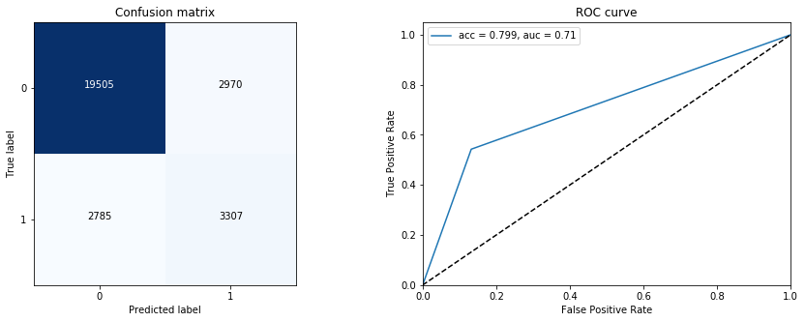
Naive Bayes

Slide 19

Applications
Default payment prevention
More parameters for interest rate calculations
Applicable to other types of payment tools
More information for rating clients
Applicable in other fields

Slide 20
Next steps
Detail of transactions (Privacy problem)
Neuronal Network
More balance dataset

Slide 21

Thanks for your attention.

